Slide 1
CSC 236
Tutorial Number - Daniel Razavi
“OMG THE MIDTERM WAS SO BAD OMG IM DONE WITH THIS CLASS ASKDGKADFASDAS;KDJLASHDLJASHDLKASD”

Slide 2
I’m sorry about the YouTube Live

Slide 3
How was the Midterm?

Slide 4


Slide 5
The Slides Aren’t Up - Dw Will be up soon

Slide 6
Today’s Tutorial Problems

Slide 7
Someone in class was wondering if we can start with #3 so....

Slide 8
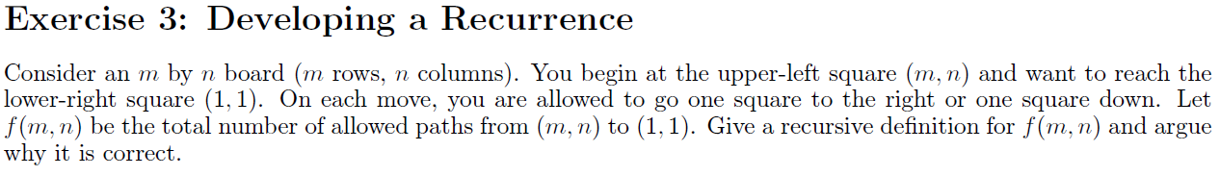

Slide 9
If we are on row 1 or column 1, then there is just one path that we can take to (1, 1): go all the way right or all the way down.
If we start at (1, 1) itself, then there is still 1 path, the empty path.

Slide 10
If we are on row 1 or column 1, then there is just one path that we can take to (1, 1): go all the way right or all the way down.
If we start at (1, 1) itself, then there is still 1 path, the empty path.
Otherwise, we start at (m, n) and
m, n >= 2. Then we have two choices for our first move:
1. We can either move down, and the number of paths from there is f(m-1, n)
2. Or we can move right, and the number of paths from there is f(m, n-1)

Slide 11
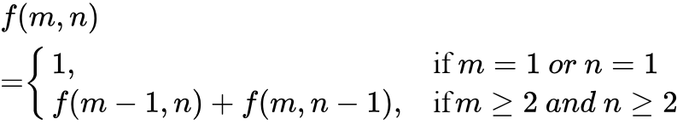
If we are on row 1 or column 1, then there is just one path that we can take to (1, 1): go all the way right or all the way down.
If we start at (1, 1) itself, then there is still 1 path, the empty path.
So our recursive function is:
Otherwise, we start at (m, n) and
m, n >= 2. Then we have two choices for our first move:
1. We can either move down, and the number of paths from there is f(m-1, n)
2. Or we can move right, and the number of paths from there is f(m, n-1)
Notes:
f(m,n)=
\begin{cases}
1,& \text{if } m = 1\ or\ n = 1\\
f(m-1,n) + f(m,n-1), & \text{if}m\ge 2\ and \ n\ge2
\end{cases}

Slide 12
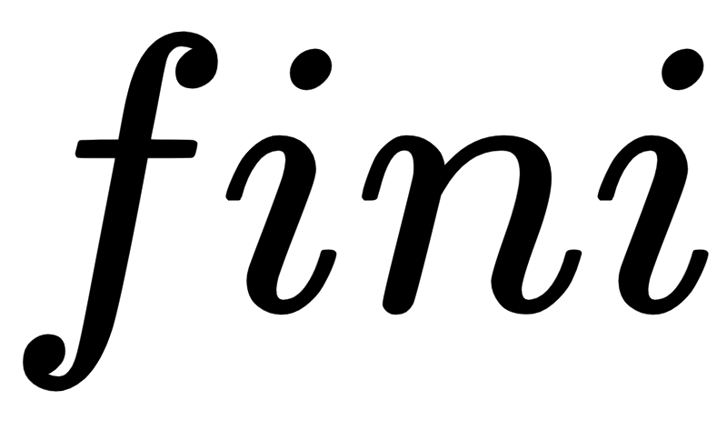
If we are on row 1 or column 1, then there is just one path that we can take to (1, 1): go all the way right or all the way down.
If we start at (1, 1) itself, then there is still 1 path, the empty path.
So our recursive function is:
Otherwise, we start at (m, n) and
m, n >= 2. Then we have two choices for our first move:
1. We can either move down, and the number of paths from there is f(m-1, n)
2. Or we can move right, and the number of paths from there is f(m, n-1)
Notes:
f(m,n)=
\begin{cases}
1,& \text{if } m = 1\ or\ n = 1\\
f(m-1,n) + f(m,n-1), & \text{if}m\ge 2\ and \ n\ge2
\end{cases}

Slide 13
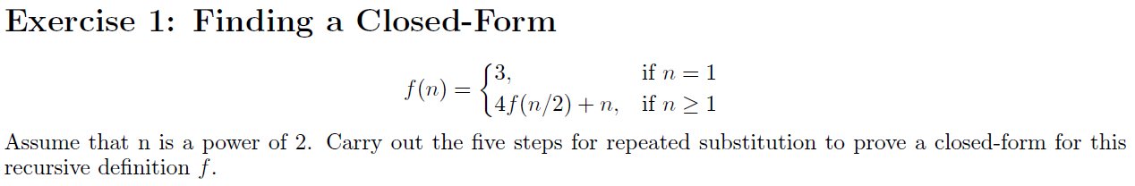

Slide 14
Step 1
Substitute a few times

Slide 15
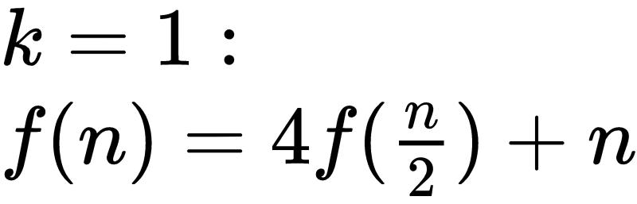
Step 1
Substitute a few times

Slide 16
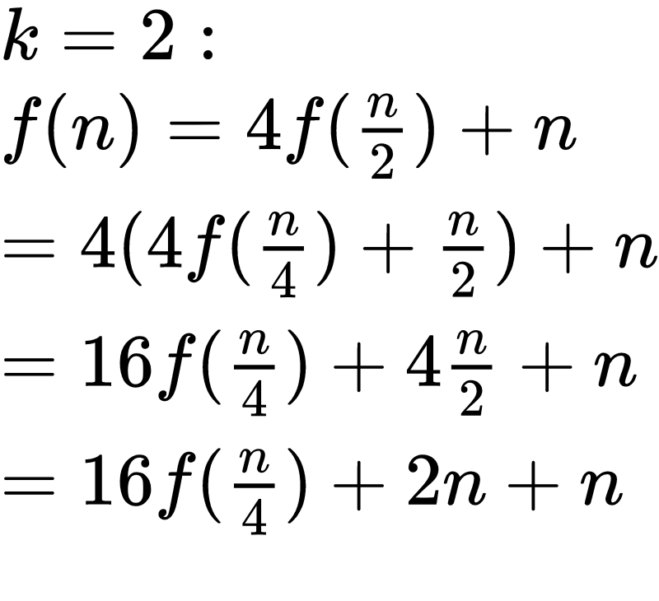
Step 1
Substitute a few times
BTW: While substituting, constantly look for patterns in your expansions.

Slide 17
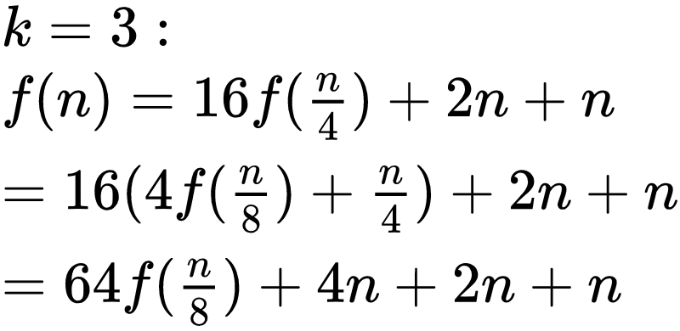
Step 1
Substitute a few times

Slide 18
Step 1
Substitute a few times
Dp you see any patterns?

Slide 19
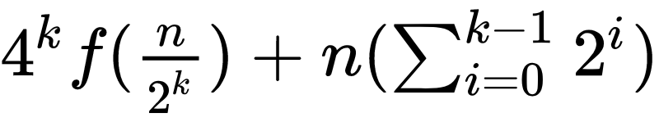
Step 2
Finding a pattern!
Well I can see a pattern from the three test substitutions I had:
It seems to be be good!

Slide 20
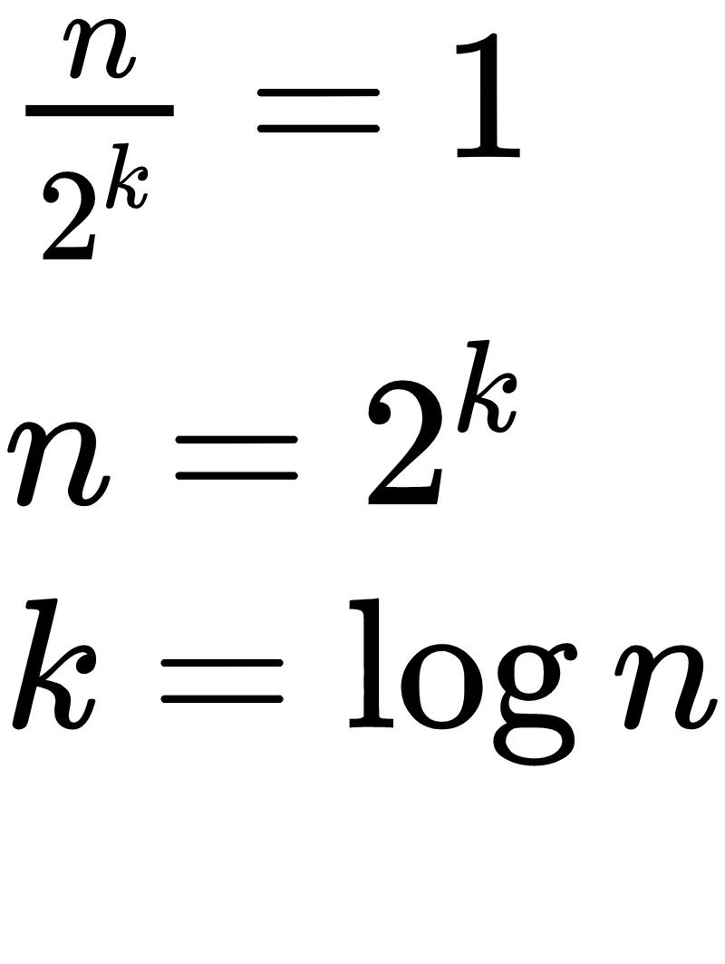
Step 3
Solve for k
Reminder: Log has a default base of 2 in this course
So:

Slide 21
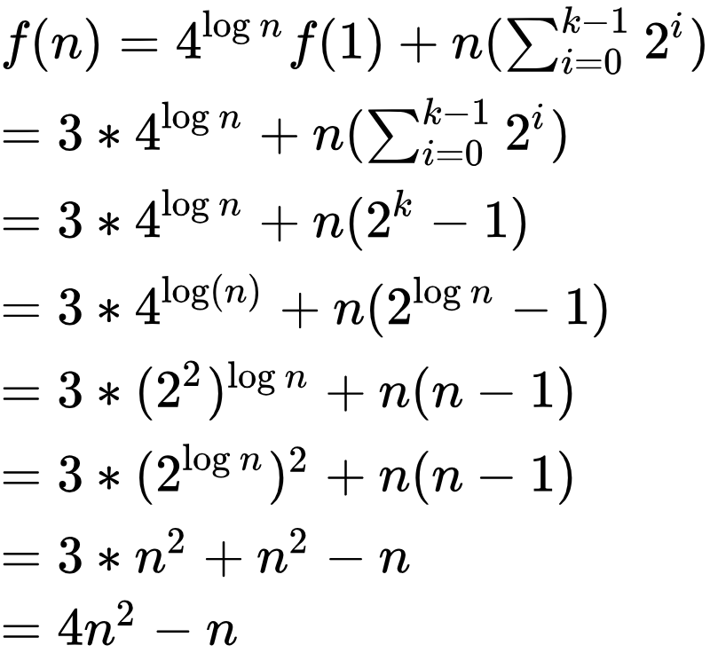

Step 4
Substitute K into the formula
Notes:
f(n) = 4^{\log n}f(1)+n(\sum_{i=0}^{k - 1} 2^i) \\
=3* 4^{\log n}+n(\sum_{i=0}^{k - 1} 2^i) \\
=3* 4^{\log n}+n(2^k-1) \\
= 3*4^{\log(n)}+n(2^{\log n}-1)\\
= 3*(2^2)^{\log n} + n(n-1)\\
= 3*(2^{\log n})^2 + n(n-1) \\
= 3*n^2 + n^2 -n \\
= 4n^2 - n

Slide 22
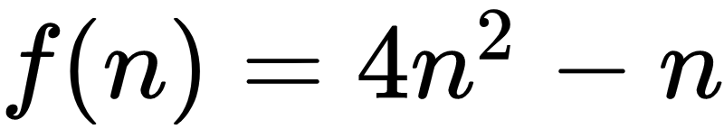
Step 5
Prove this is correct using mathematical induction
Notes:
f(n) = 4^{\log n}f(1)+n(\sum_{i=0}^{k - 1} 2^i) \\
=3* 4^{\log n}+n(\sum_{i=0}^{k - 1} 2^i) \\
=3* 4^{\log n}+n(2^k-1) \\
= 3*4^{\log(n)}+n(2^{\log n}-1)\\
= 3*(2^2)^{\log n} + n(n-1)\\
= 3*(2^{\log n})^2 + n(n-1) \\
= 3*n^2 + n^2 -n \\
= 4n^2 - n

Slide 23
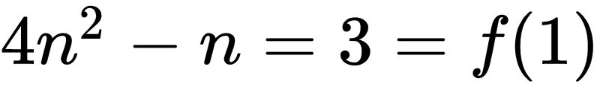
We use complete induction.
Base case:
Step 5
Prove this is correct using mathematical induction
Notes:
f(n) = 4^{\log n}f(1)+n(\sum_{i=0}^{k - 1} 2^i) \\
=3* 4^{\log n}+n(\sum_{i=0}^{k - 1} 2^i) \\
=3* 4^{\log n}+n(2^k-1) \\
= 3*4^{\log(n)}+n(2^{\log n}-1)\\
= 3*(2^2)^{\log n} + n(n-1)\\
= 3*(2^{\log n})^2 + n(n-1) \\
= 3*n^2 + n^2 -n \\
= 4n^2 - n
4f(\frac{n}{2})+n \\
= 4(4(\frac{n}{2})^2-\frac{n}{2})+n\\
= 4*4*(\frac{n}{2})^2-2n+n\\
= 4*4*\frac{n^2}{4}-2n+n\\
= 4*n^2-2n+n\\
= 4n^2-n

Slide 24
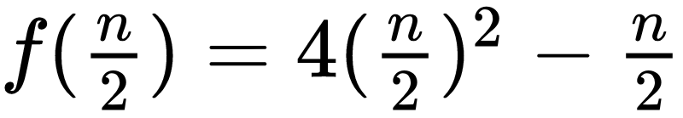
We use complete induction.
Base case:
IH: Suppose that
Step 5
Prove this is correct using mathematical induction
Notes:
f(n) = 4^{\log n}f(1)+n(\sum_{i=0}^{k - 1} 2^i) \\
=3* 4^{\log n}+n(\sum_{i=0}^{k - 1} 2^i) \\
=3* 4^{\log n}+n(2^k-1) \\
= 3*4^{\log(n)}+n(2^{\log n}-1)\\
= 3*(2^2)^{\log n} + n(n-1)\\
= 3*(2^{\log n})^2 + n(n-1) \\
= 3*n^2 + n^2 -n \\
= 4n^2 - n
4f(\frac{n}{2})+n \\
= 4(4(\frac{n}{2})^2-\frac{n}{2})+n\\
= 4*4*(\frac{n}{2})^2-2n+n\\
= 4*4*\frac{n^2}{4}-2n+n\\
= 4*n^2-2n+n\\
= 4n^2-n

Slide 25
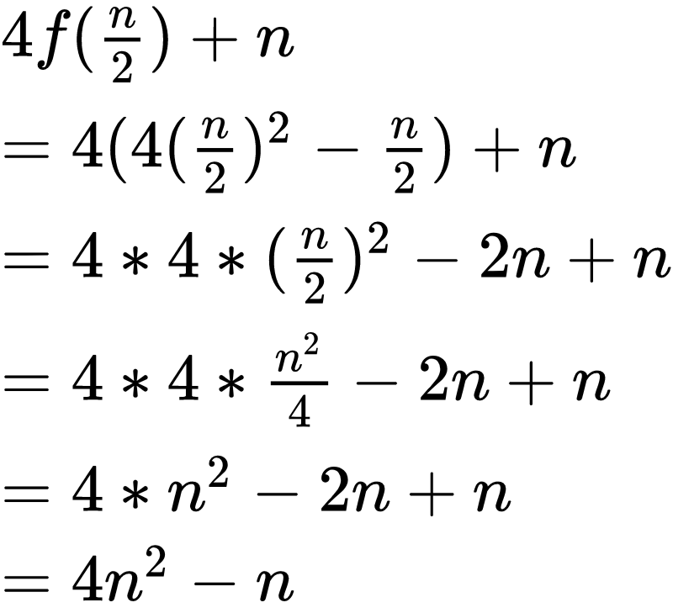
We use complete induction.
Base case:
IH: Suppose that
Then we have, for n > 1
Step 5
Prove this is correct using mathematical induction
Notes:
f(n) = 4^{\log n}f(1)+n(\sum_{i=0}^{k - 1} 2^i) \\
=3* 4^{\log n}+n(\sum_{i=0}^{k - 1} 2^i) \\
=3* 4^{\log n}+n(2^k-1) \\
= 3*4^{\log(n)}+n(2^{\log n}-1)\\
= 3*(2^2)^{\log n} + n(n-1)\\
= 3*(2^{\log n})^2 + n(n-1) \\
= 3*n^2 + n^2 -n \\
= 4n^2 - n
4f(\frac{n}{2})+n \\
= 4(4(\frac{n}{2})^2-\frac{n}{2})+n\\
= 4*4*(\frac{n}{2})^2-2n+n\\
= 4*4*\frac{n^2}{4}-2n+n\\
= 4*n^2-2n+n\\
= 4n^2-n

Slide 26
We use complete induction.
Base case:
IH: Suppose that
Then we have, for n > 1
Step 5
Prove this is correct using mathematical induction
Notes:
f(n) = 4^{\log n}f(1)+n(\sum_{i=0}^{k - 1} 2^i) \\
=3* 4^{\log n}+n(\sum_{i=0}^{k - 1} 2^i) \\
=3* 4^{\log n}+n(2^k-1) \\
= 3*4^{\log(n)}+n(2^{\log n}-1)\\
= 3*(2^2)^{\log n} + n(n-1)\\
= 3*(2^{\log n})^2 + n(n-1) \\
= 3*n^2 + n^2 -n \\
= 4n^2 - n
4f(\frac{n}{2})+n \\
= 4(4(\frac{n}{2})^2-\frac{n}{2})+n\\
= 4*4*(\frac{n}{2})^2-2n+n\\
= 4*4*\frac{n^2}{4}-2n+n\\
= 4*n^2-2n+n\\
= 4n^2-n

Slide 27
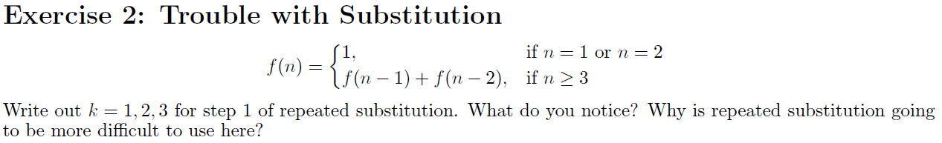
Notes:
http://gozips.uakron.edu/~crm23/fibonacci/fibonacci.htm

Slide 28

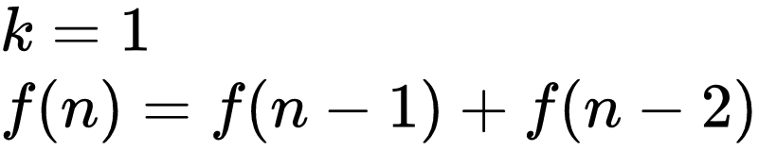
There is going to be so many terms...
Even if you only expand the first term (leaving the second one alone to avoid accumulation of more and more terms), here's what happens:
Notes:
http://gozips.uakron.edu/~crm23/fibonacci/fibonacci.htm

Slide 29
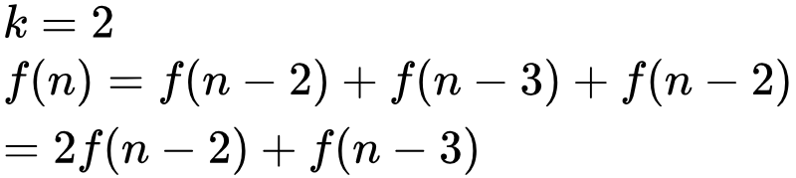
There is going to be so many terms...
Even if you only expand the first term (leaving the second one alone to avoid accumulation of more and more terms), here's what happens:
Notes:
http://gozips.uakron.edu/~crm23/fibonacci/fibonacci.htm

Slide 30
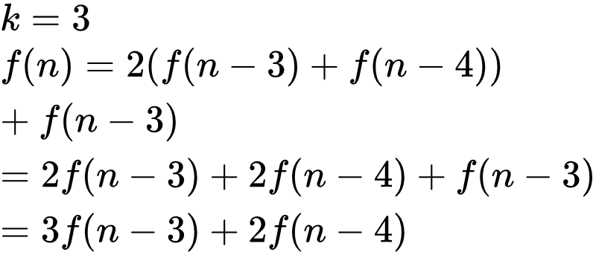
There is going to be so many terms...
Even if you only expand the first term (leaving the second one alone to avoid accumulation of more and more terms), here's what happens:
Notes:
http://gozips.uakron.edu/~crm23/fibonacci/fibonacci.htm

Slide 31
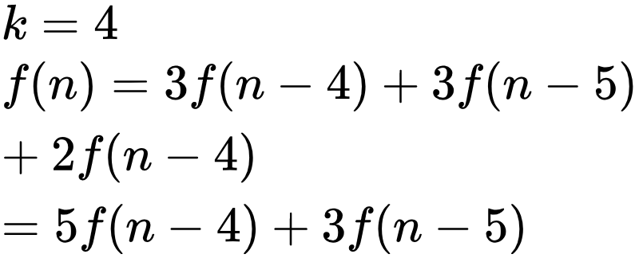
There is going to be so many terms...
Even if you only expand the first term (leaving the second one alone to avoid accumulation of more and more terms), here's what happens:
Notes:
http://gozips.uakron.edu/~crm23/fibonacci/fibonacci.htm

Slide 32
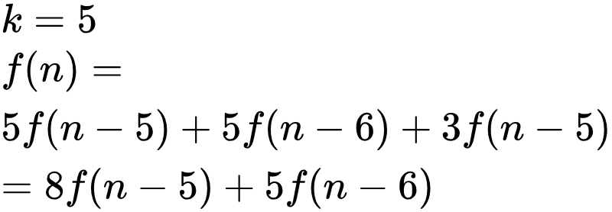
There is going to be so many terms...
Even if you only expand the first term (leaving the second one alone to avoid accumulation of more and more terms), here's what happens:
Notes:
http://gozips.uakron.edu/~crm23/fibonacci/fibonacci.htm

Slide 33
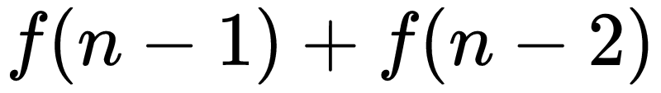
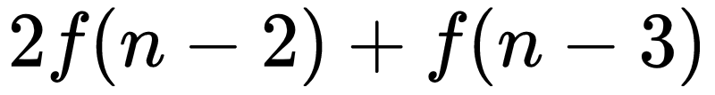
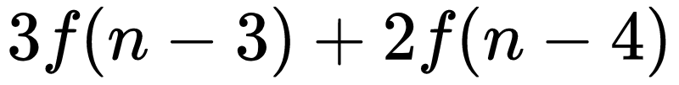
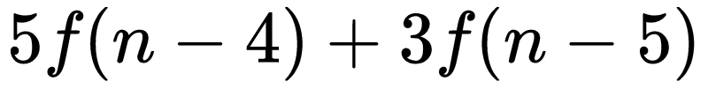
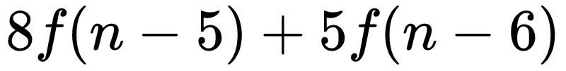
Putting Them Side By Side:
There is going to be so many terms...
Even if you only expand the first term (leaving the second one alone to avoid accumulation of more and more terms), here's what happens:
Notes:
http://gozips.uakron.edu/~crm23/fibonacci/fibonacci.htm

Slide 34
There is going to be so many terms...
Putting Them Side By Side:
Even if you only expand the first term (leaving the second one alone to avoid accumulation of more and more terms), here's what happens:
These coefficients look like the Fibonacci numbers! Which is exactly the function for which we're trying to find a closed-form!
Notes:
http://gozips.uakron.edu/~crm23/fibonacci/fibonacci.htm

Slide 35
In general, when there are multiple different-looking terms f(m), f(n), etc., then it's likely that the substitution method won't help. It still works for some lucky cases, like:
2T(n-1)-T(n-2)
Notes:
http://gozips.uakron.edu/~crm23/fibonacci/fibonacci.htm

Slide 36
In general, when there are multiple different-looking terms f(m), f(n), etc., then it's likely that the substitution method won't help. It still works for some lucky cases, like:
2T(n-1)-T(n-2)
Notes:
http://gozips.uakron.edu/~crm23/fibonacci/fibonacci.htm

Slide 37
CSC 236
Tutorial 4 - Daniel Razavi

